Slide 1
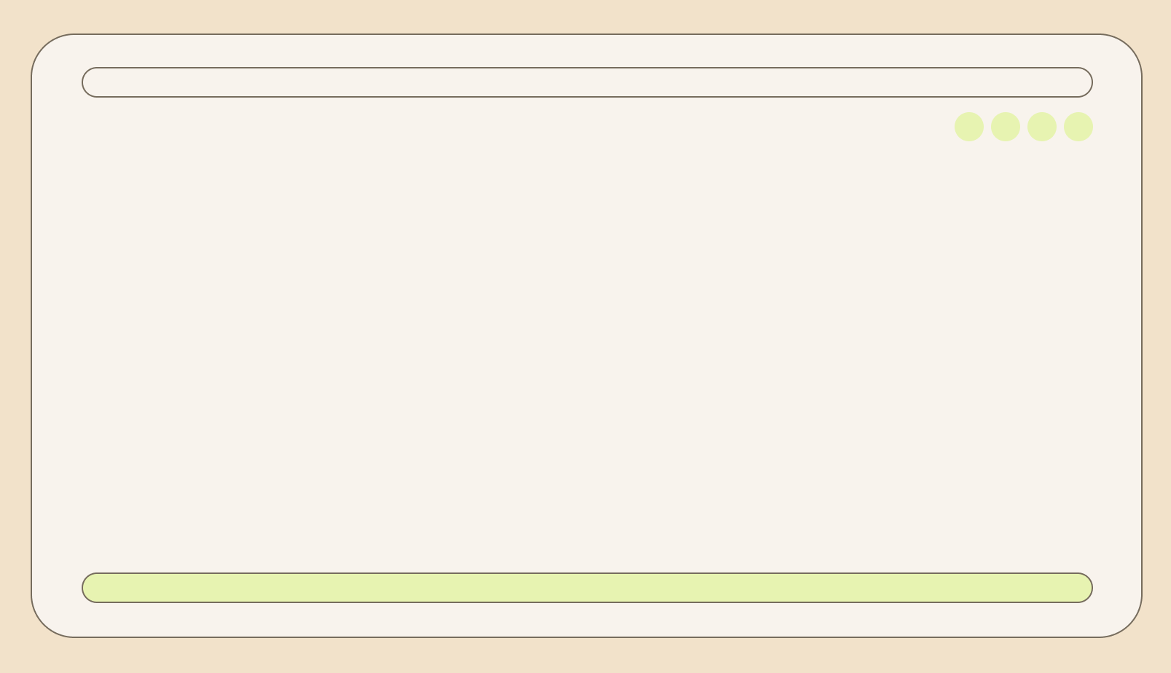


Telecom Customer Churn Prediction
Presenter: Imtiaz Faruk
Date : 20.02.2025

Slide 2
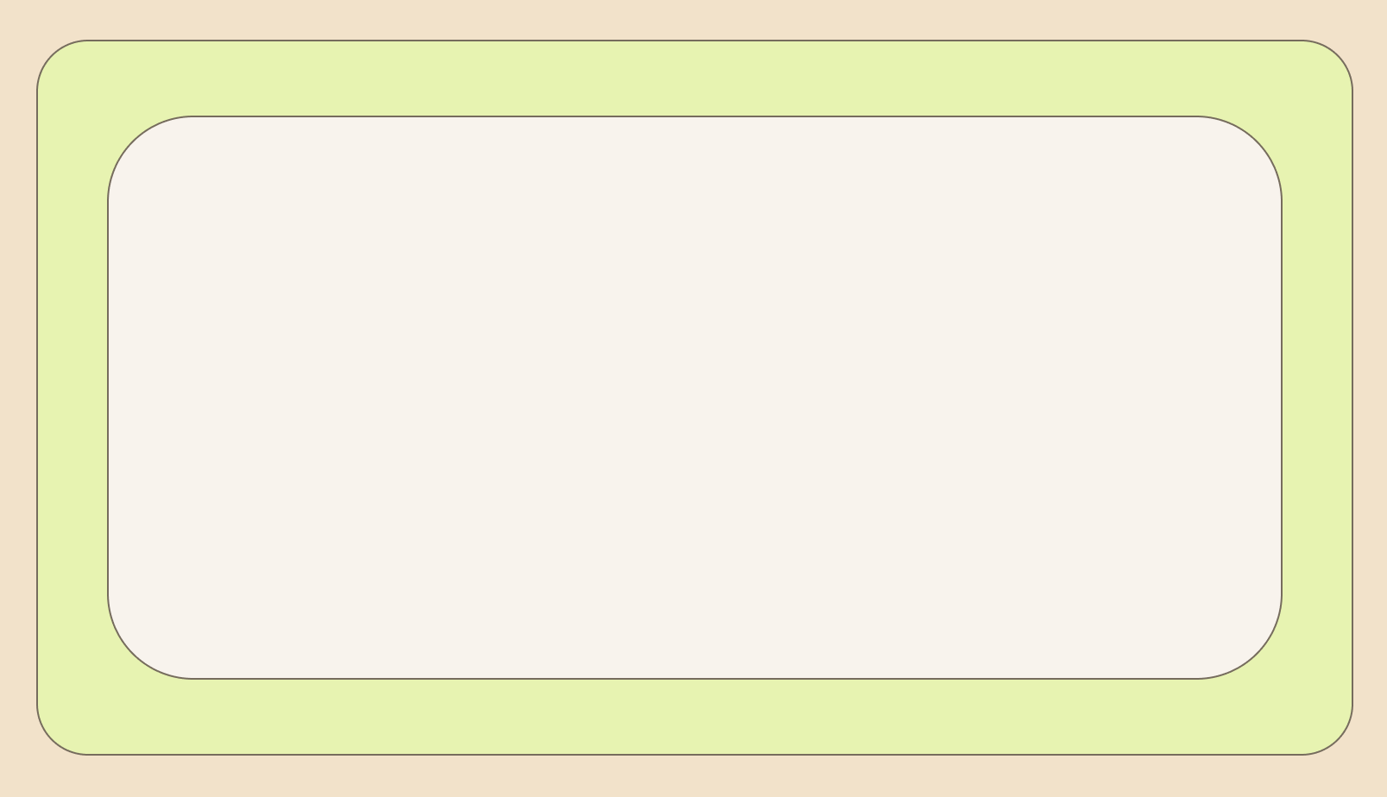
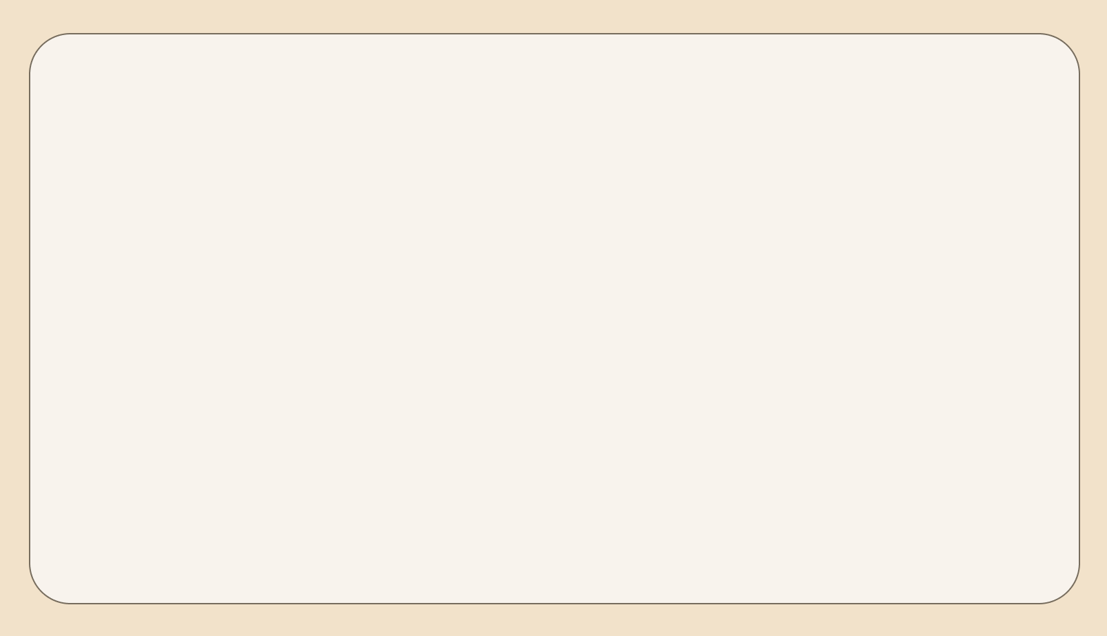

Section 1
Understanding Customer Churn in the Telecom Industry
Definition: Customer churn refers to when customers stop using a company's services.
Churn in Telecom:
High competition leads to easy customer switching.
Dissatisfaction or less engagement with the customer leading to churn.

Slide 3
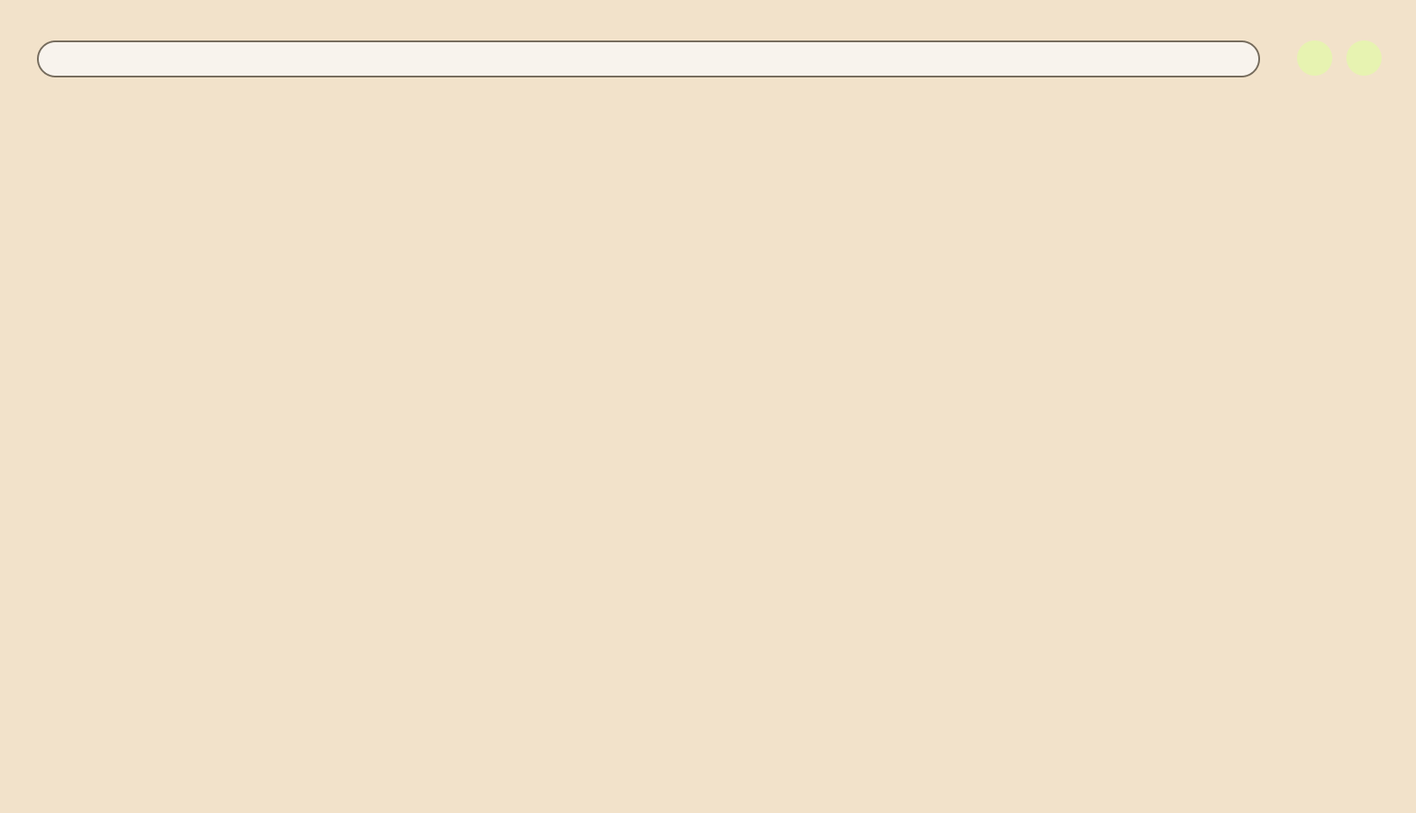

Importance of Customer Churn
Why It Matters?
Loss of revenue
Increased acquisition costs
Indicator of customer dissatisfaction
Why is churn prediction important?
Helps companies retain customers.
Reduces acquisition costs by focusing on retention.
Enhances customer satisfaction and brand loyalty.

Slide 4
Section 2
Section 2
Overview of the dataset

Slide 5
About The Dataset
In this project I’ve worked with the Telco Customer Churn Data in USA (IBM Cognos analytics sample dataset). It is artificiality generated dataset by IBM Cognos Analytics platform for Research and Analysis purpose.
Objective of the Project :
The primary goal of this project is to predict customer churn—that is, to determine which customers are likely to stop using a service based on their historical data and behavioral patterns.

Slide 6
Section 3
EDA and Visualizations

Slide 7
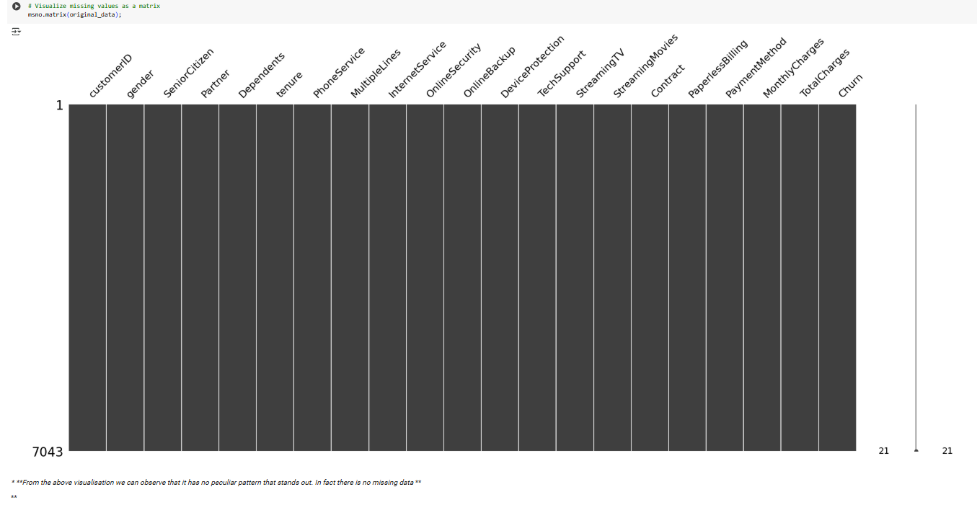
Exploratory Data Analysis
This dataset consists of 7043 rows and 21 columns.
My target column is “Churn”. After the manipulation, I worked with 7032 rows.

Slide 8
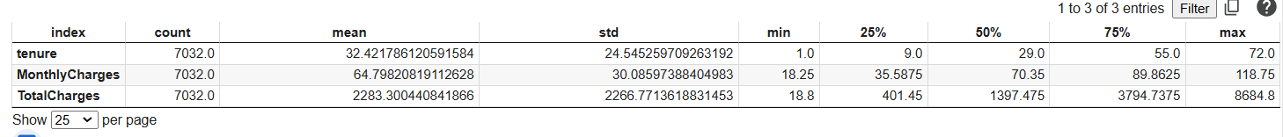
Data Manipulation
1. Drop the Customer ID column
2. Convert the TotalCharges column from object to numeric
3. Then we found 11 NaN values in TotalCharges column
4. Update those NaN values with the mean
5. Now searching for the 0 values in tenure column and found 11 values with 0.
6. Drop this 11 rows.
Now, we found no missing values.
7. Then map the SeniorCitizen column with Yes or No.

Slide 9
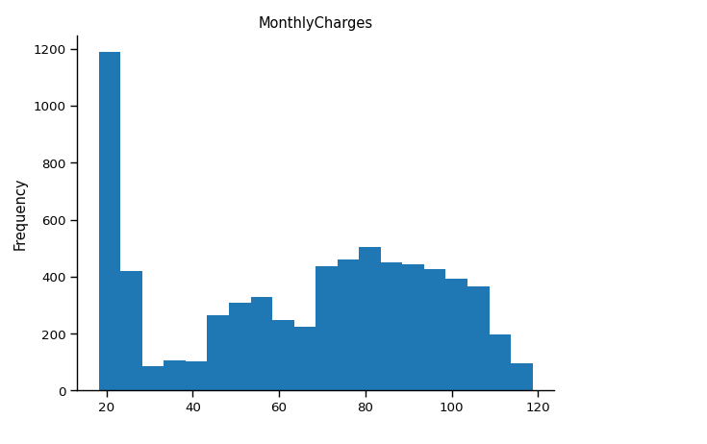
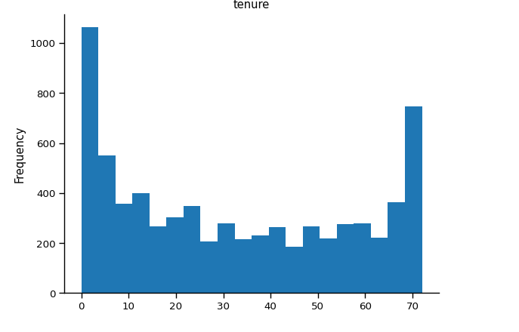


Exploratory Data Analysis & Visualizations
Monthly Charges vs. Frequency
Tenure vs. Frequency
Tenure : Number of months the customer has stayed with the company

Slide 10
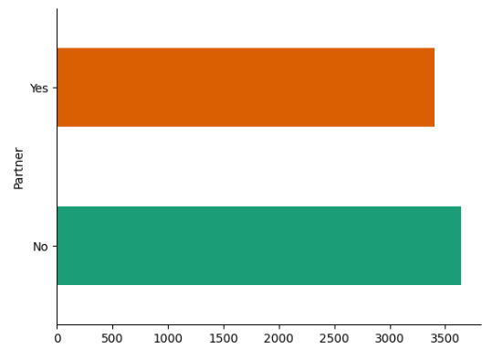
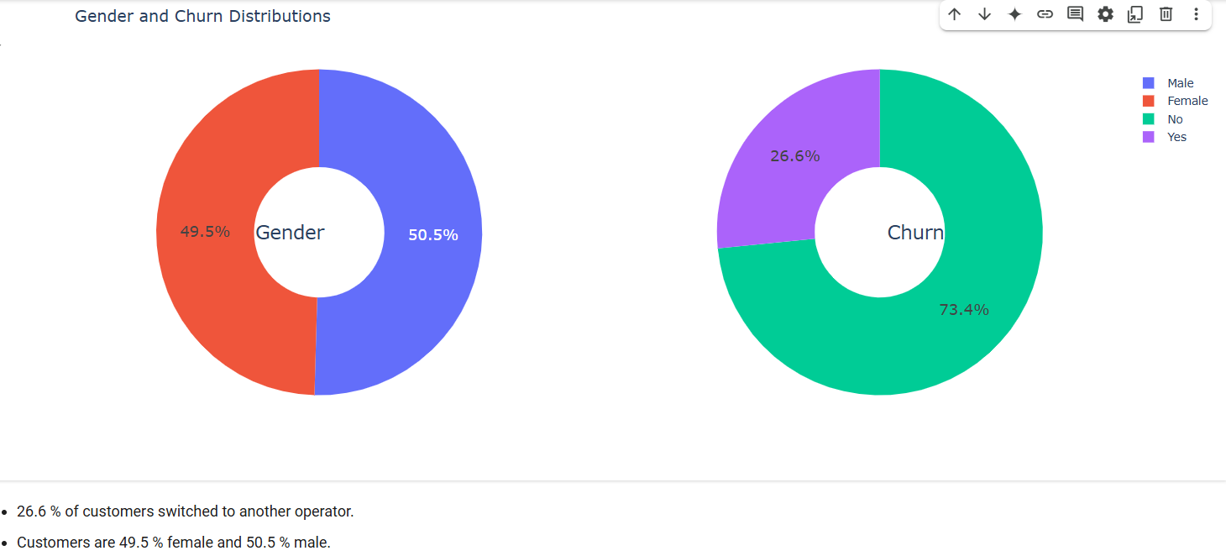






Exploratory Data Analysis & Visualizations
Churn w.r.t. Partner
Churn w.r.t. Gender
Churn Rate
w.r.t. = with respect to

Slide 11
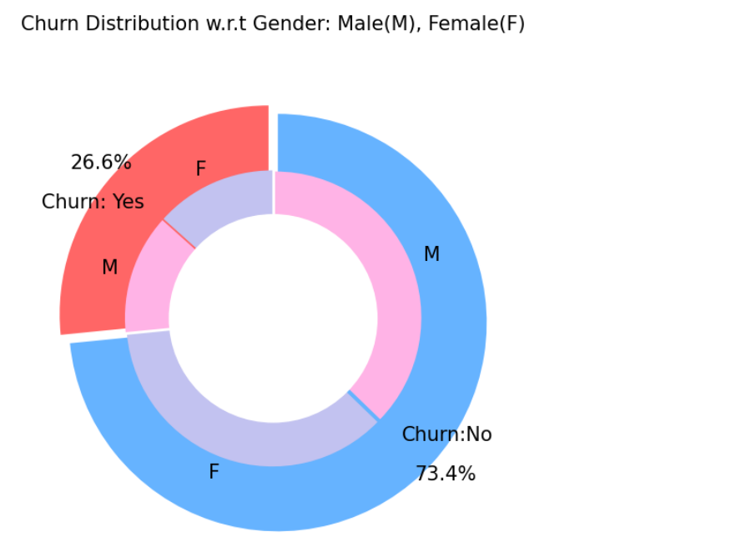
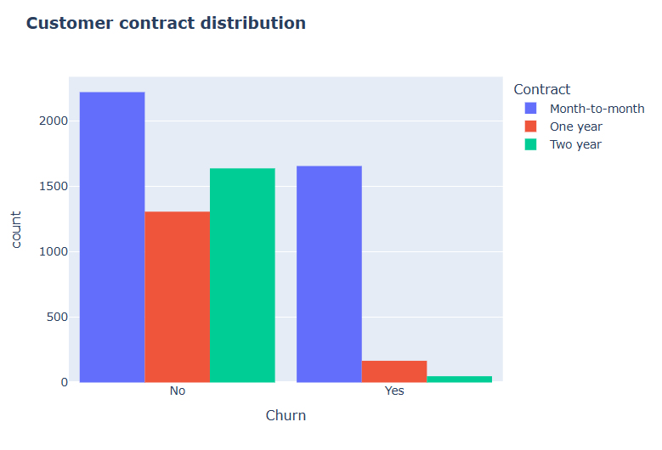
Exploratory Data Analysis & Visualizations
Here For No Churn :: month-to-month contract, we have 2220 Customers …One year contract , we have 1306 customers.. Two years contract, we have 1637 customers
And For Churn IS Yes :: month-to-month contract, we have 1655 Customers… One year contract , we have 166 customers..Two years contract, we have 48 customers..
Here for No Churn, We have 2619 Male and 2544 Female
Here for Churn = Yes , We have 930 Male and 939 Female

Slide 12
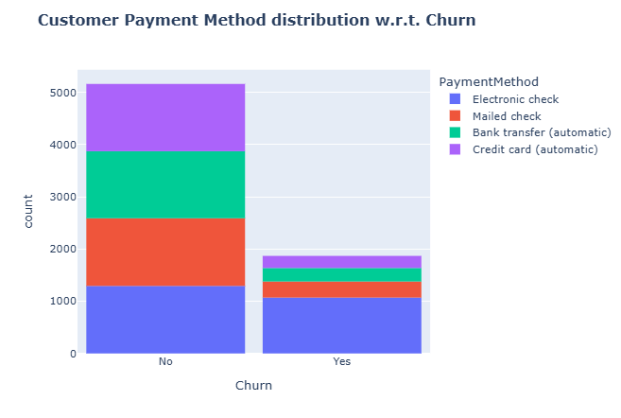
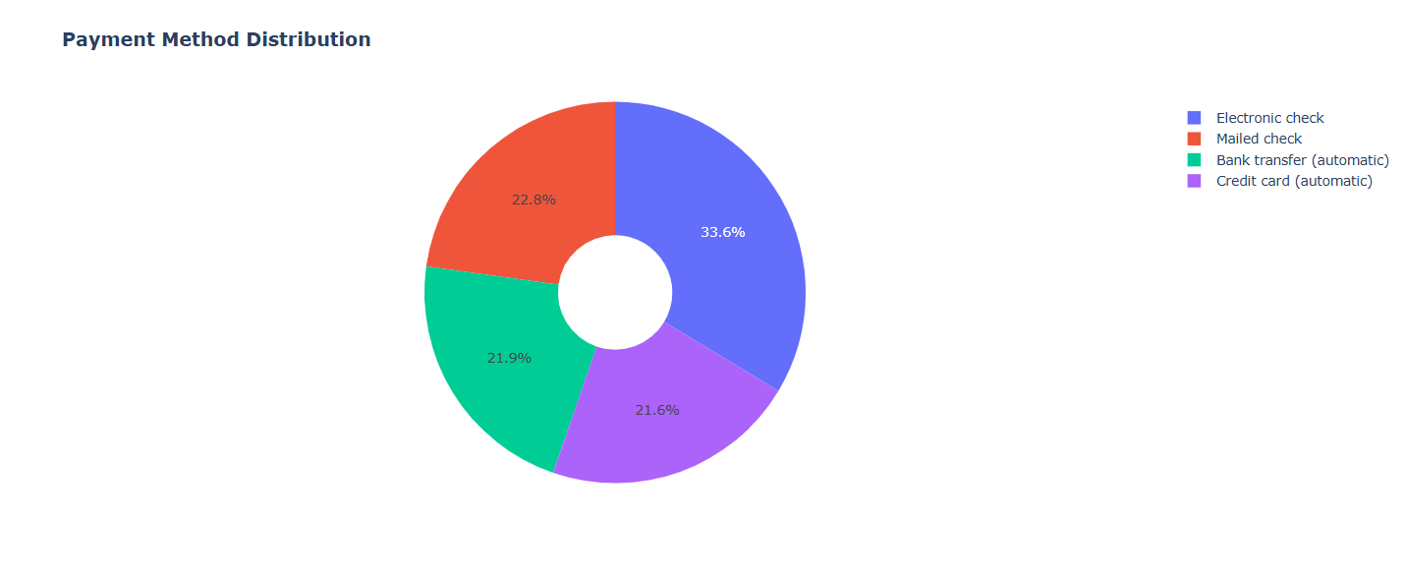
Exploratory Data Analysis & Visualizations
Payment Distribution
Here 2365 people use Electronic check method
Here 1521 people use Credit card method
Here Most of the people who have used Electronic check have churned (almost 1k)

Slide 13
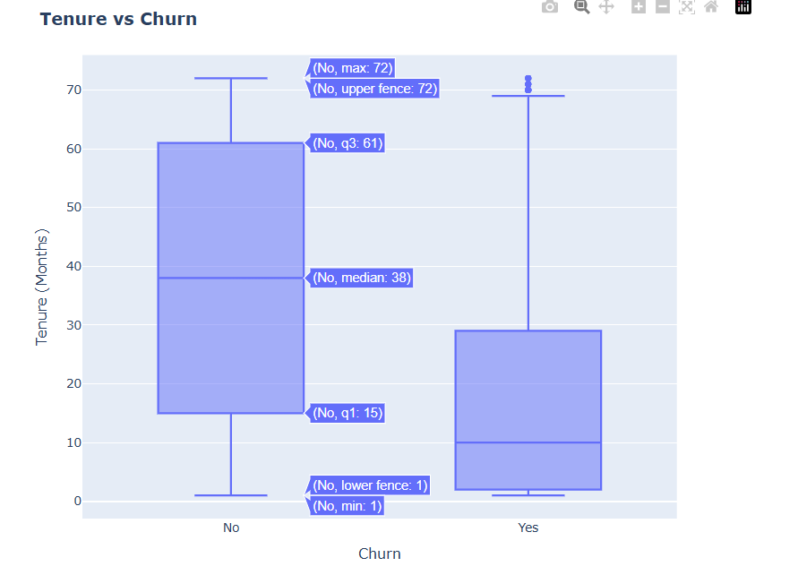
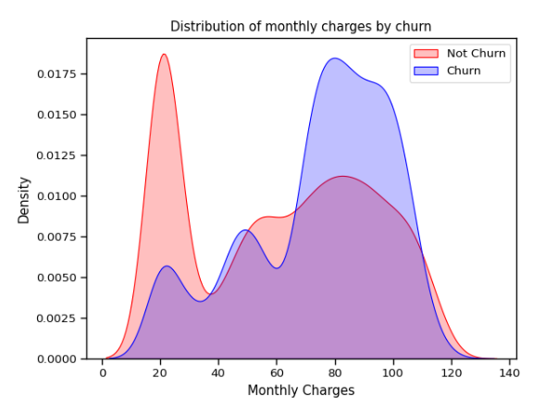
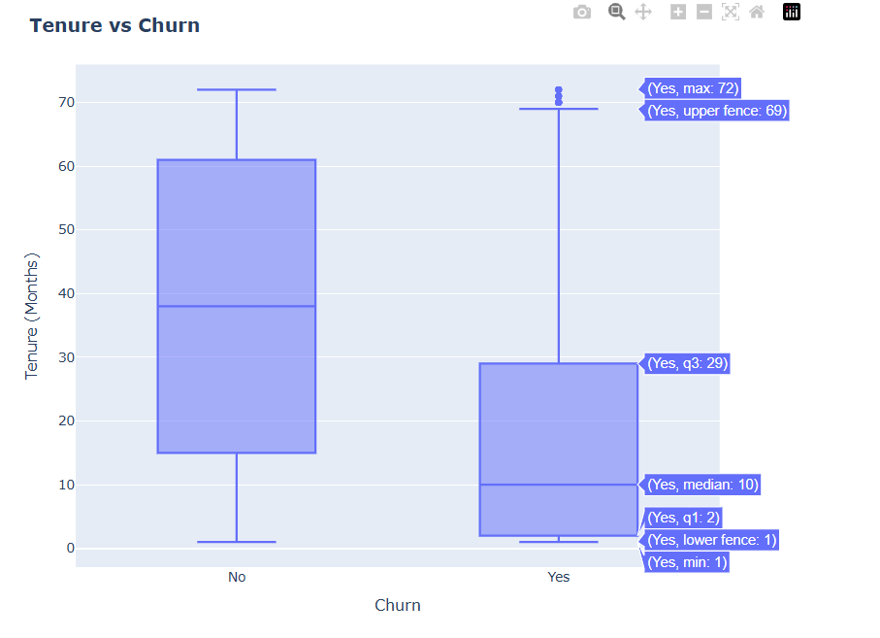
Exploratory Data Analysis & Visualizations
Distribution of monthly charges
KDE : Kernel Density Estimate
Here , Y axis : estimated probability distribution
The larger the gap between red and blue curves, the greater the difference in churn behaviour.

Slide 14
Section 4
Statistical Analysis

Slide 15
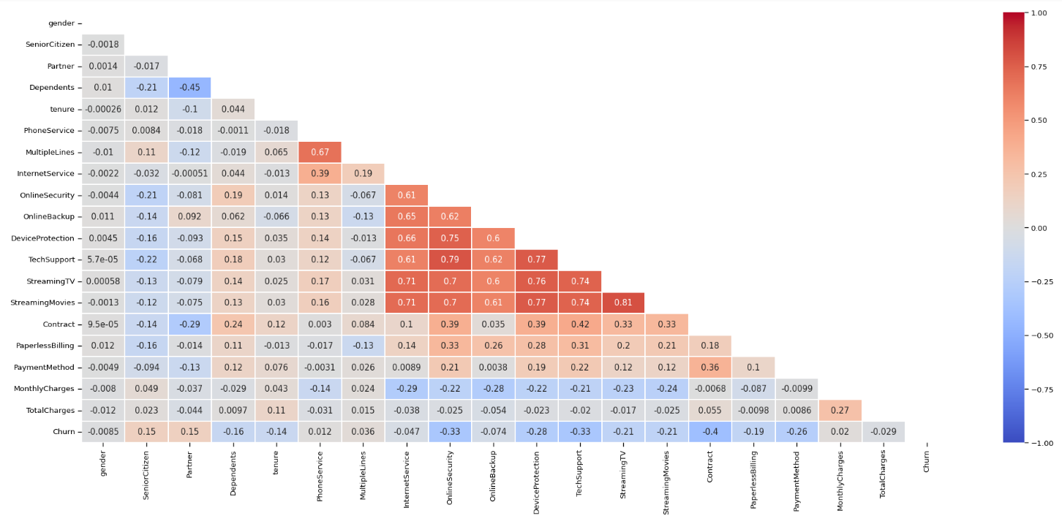

Exploratory Data Analysis & Visualizations
Correlation Matrix

Slide 16
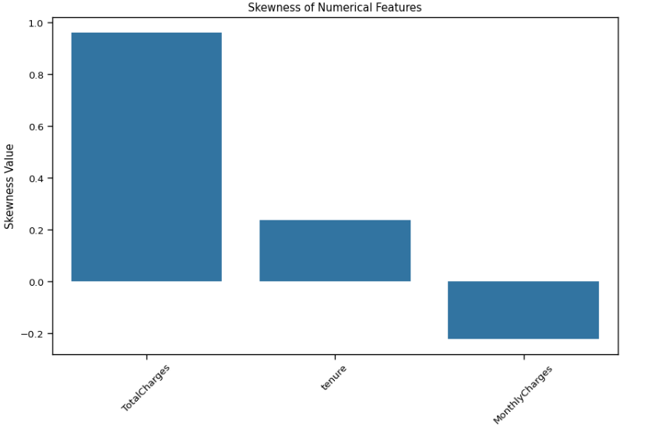

Exploratory Data Analysis & Visualizations
Skewness of Numerical Features
**Here are the skewness values for the numerical features:
TotalCharges: 0.96 (Highly skewed)
Tenure: 0.24 (Moderately skewed)
MonthlyCharges: -0.22 (Slightly skewed)**
Skewness measures the asymmetry of data distribution, helping to identify whether features are normally distributed or skewed.

Slide 17
Section 5
Machine Learning Algorithms

Slide 18
Machine Learning Approach
Some Preprocessing :
OneHotEncoder() for Categorical Data
StandardScaler()for Numerical Data
Then, I follow these steps :
Building the model pipeline
Train the model
Use the train_test_split method from sklearn package and split the data into 80/20 ratio
Then evaluate the model and predict the outcome

Slide 19
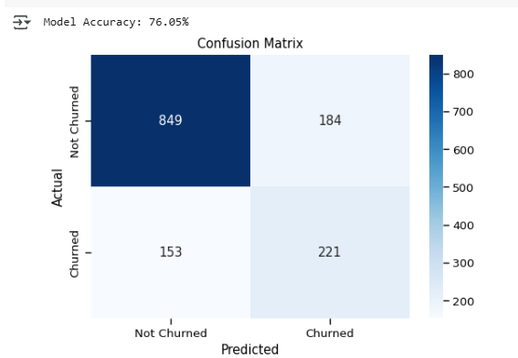
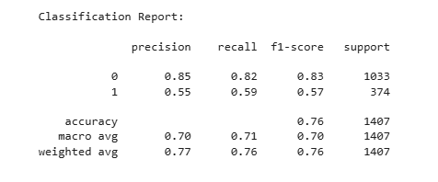
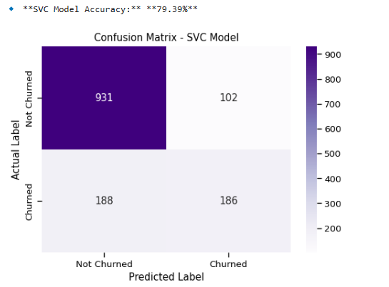
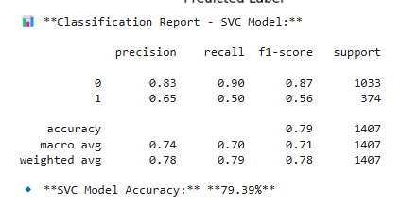
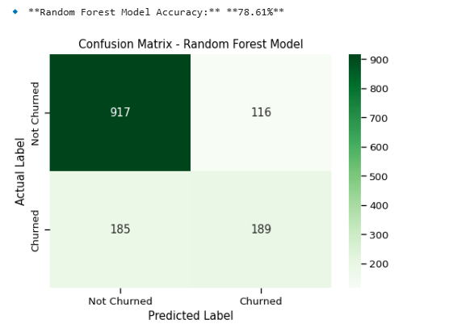
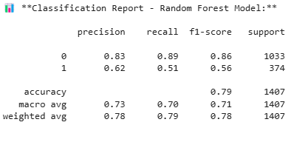
Used Machine Learning Althorithms and their Performances
K-Nearest-Neighbor Classifier :
2. Support Vector Machine Classifier :
3. Random Forest Classifier :
Precision = (TP / (TP + FP))
Recall = (TP / (TP + FN))

Slide 20
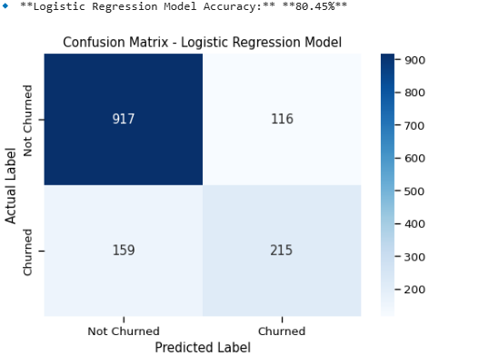
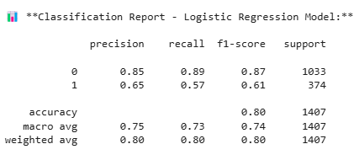
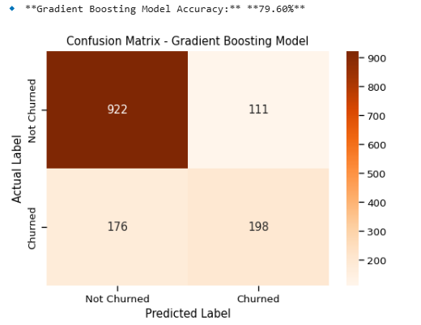
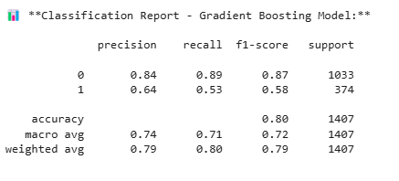
Used Machine Learning Althorithms and their Performances
Logistic Regression Classifier :
2. Gradient Boosting Classifier :
So, Logistic Regression method gives us the most Accuracy (80.45%)

Slide 21
Section 6
Structured Query Language & Tableau

Slide 22


Some Business Quires Using SQL
1. Identify the Top 5 Most Valuable Customers (Highest Charges) :
2. Find the Churn Rate Segmented by Internet Service Type :
3. Identify the Most Common Tenure Period Among Churned Customers :
4. Compare Monthly Charges for Customers with Different Payment Methods :
5. Identify the Most Common Services Among Long-Term Customers :
6. Find the Total Revenue Lost Due to Churn:
7. Find Which Contract Type Generates the Most Revenue:
8. Predict Potential Churn Based on Monthly Charges and Contract Type:
Visualizing these results in Tableau
Click Here : https://public.tableau.com/authoring/CustomerChurnDashboardu/Dashboard1#1

Slide 23
Section 7
Recommandations & Conclusion

Slide 24
Some Key Insights to Concern
Key Insights:
Customers on month-to-month contracts have higher churn rates.
One of the five customers pause / stop their services.
Electronic payment methods show higher churn compared to bank transfers.
Tenure plays a crucial role – new customers are more likely to churn.
Logistic Regression Algorithm fits with the best prediction result.

Slide 25
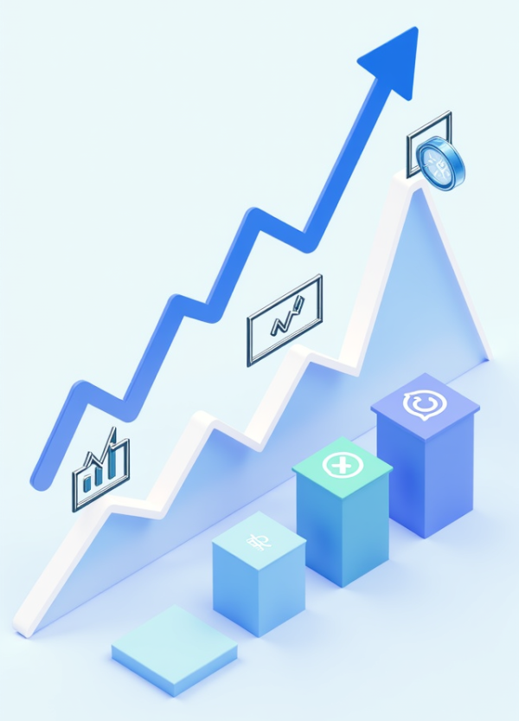
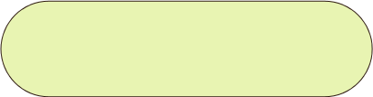
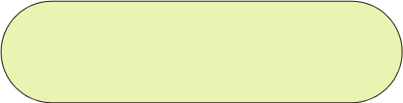
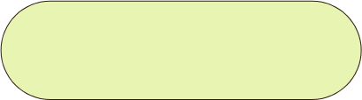

Strategies for Reducing Customer Churn
Customer Feedback Mechanisms
Implement regular surveys and feedback channels to gather insights, enabling tailored services that address customer pain points and enhance satisfaction.
Predictive Analytics Utilization
Leverage predictive analytics to identify at-risk customers, allowing for timely interventions with personalized offers to improve retention rates.
Loyalty Programs Development
Design and implement loyalty programs that reward long-term customers, fostering a sense of value and encouraging continued engagement with the brand.

Slide 26
Future Implementations
Creating a good User Interface (e.g. streamlit) for better user experience.
Working with negation of the FP and FN (Balanced Precision & Recall) for gaining better outcome.
Implementing other machine learning algos for better prediction.
Beautification of the Visualization tool (e.g. Tableau).

Slide 27
Thank You

